Slide 1
HEALTHCARE OPTIMIZATION

Slide 2

Internship project
Project title : Data-Driven strategies for healthcare optimization
Team Members:
Bhukya Vivek (lead)
Jaligama Venkatesh
N Vinod Rathod
Kurra Kusuma
College Name :GURU NANAKINSTITUTIONS TECHNICAL CAMPUS (AUTONOMOUS), IBRAHIMPATNAM , HYDERABAD

Slide 3
AGENDA:
Abstract
Introduction
Application
Advantages & Disadvantages
Technical Specification
Working Procedure
Conclusion
Thank you

Slide 4
ABSTRACT
In an era where healthcare systems globally face escalating challenges including rising costs, resource constraints, and increasing patient demands, the need for innovative solutions to optimize healthcare delivery has never been more pressing. This paper proposes an approach centered on harnessing the power of data-driven strategies to tackle these complex issues.
Through the utilization of advanced analytics, machine learning, and big data techniques, our research aims to uncover valuable insights hidden within vast healthcare datasets. By analyzing patient demographics, medical histories, treatment outcomes, and operational efficiencies, we seek to identify patterns, correlations, and predictive models that can inform strategic decision-making across the healthcare spectrum.

Slide 5
Introduction
Rising challenges in healthcare delivery, including cost management, resource allocation, and patient satisfaction
Exploration of the vast potential of healthcare data, including electronic health records, medical imaging, and wearable device data
Overview of advanced analytics, machine learning, and big data techniques as tools for extracting insights from complex healthcare datasets
Key objectives of data-driven healthcare optimization, including enhancing clinical outcomes, improving patient experience, and optimizing resource allocation

Slide 6
application
Clinical Decision Support Systems (CDSS)
Predictive Analytics for Disease Management
Healthcare Resource Allocation
Patient Engagement and Experience
Operational Efficiency and Cost Reduction
Public Health Surveillance and Outbreak Detection

Slide 7
advaNtAges
Evidence-Based Decision Making
Personalized Patient Care
Healthcare Resource Allocation
Early Disease Detection and Prevention
Operational Efficiency and Cost Savings
Improved Patient Outcomes
Enhanced Population Health Management
Continuous Quality Improvement

Slide 8
disadvaNtAges
Data Privacy and Security Concerns
Data Quality and Reliability Issues
Complexity and Integration Challenges
Algorithmic Bias and Interpretability
Resistance to Change and Adoption Barriers
Resource Constraints and Costs
Ethical and Regulatory Considerations

Slide 9
Technical specification
Operating System : Windows 7/8/10/11
Platform : Jupyter Notebook
Programming Language : Python
Front End : Visual Studio Code

Slide 10
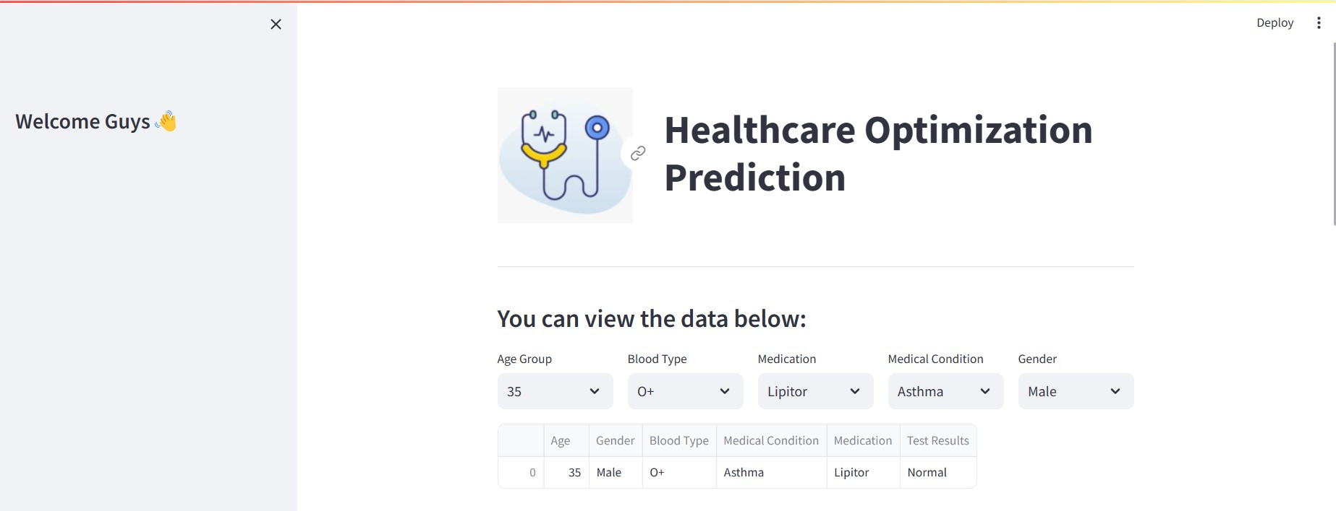
Working PROCEDURE

Slide 11
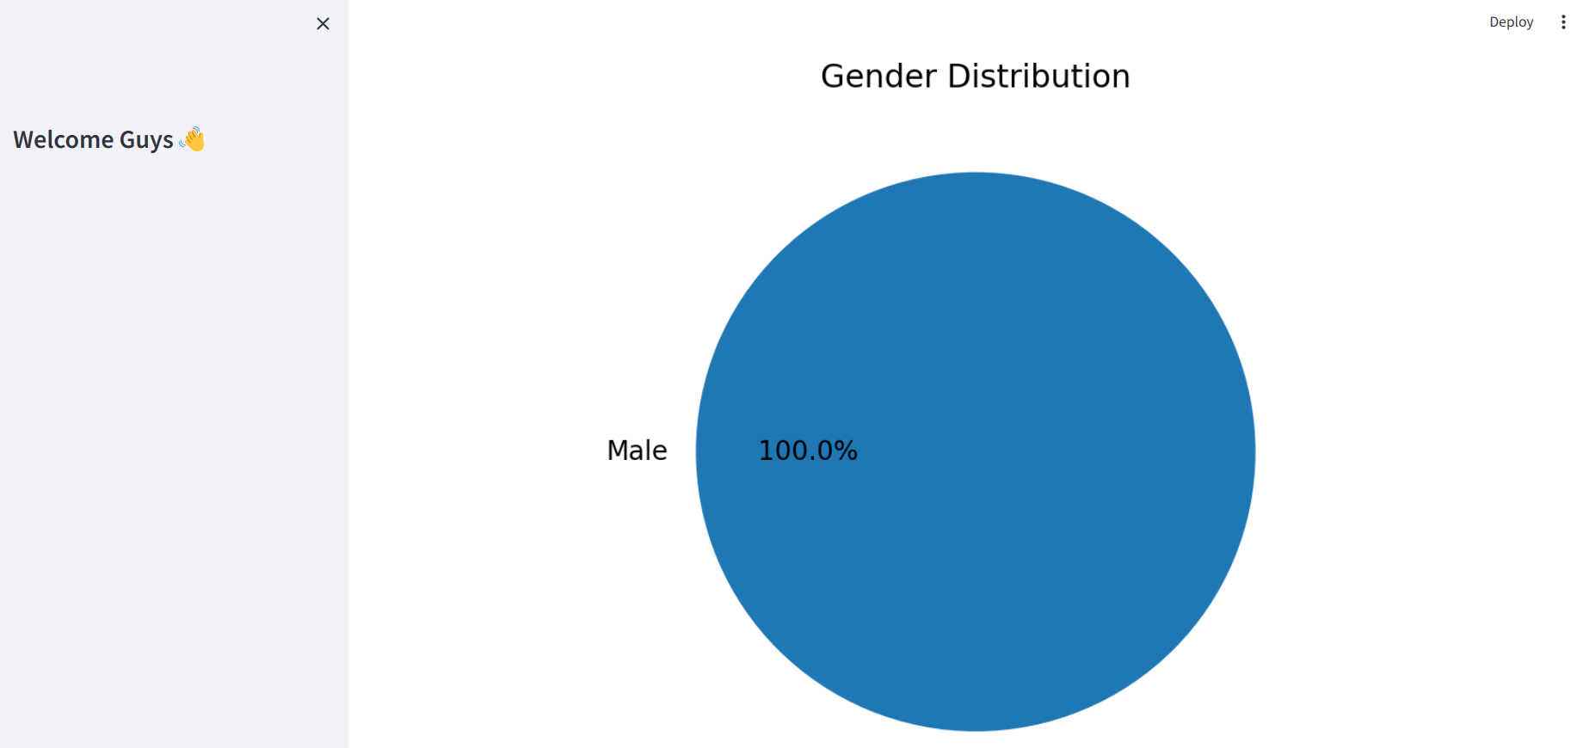

Slide 12
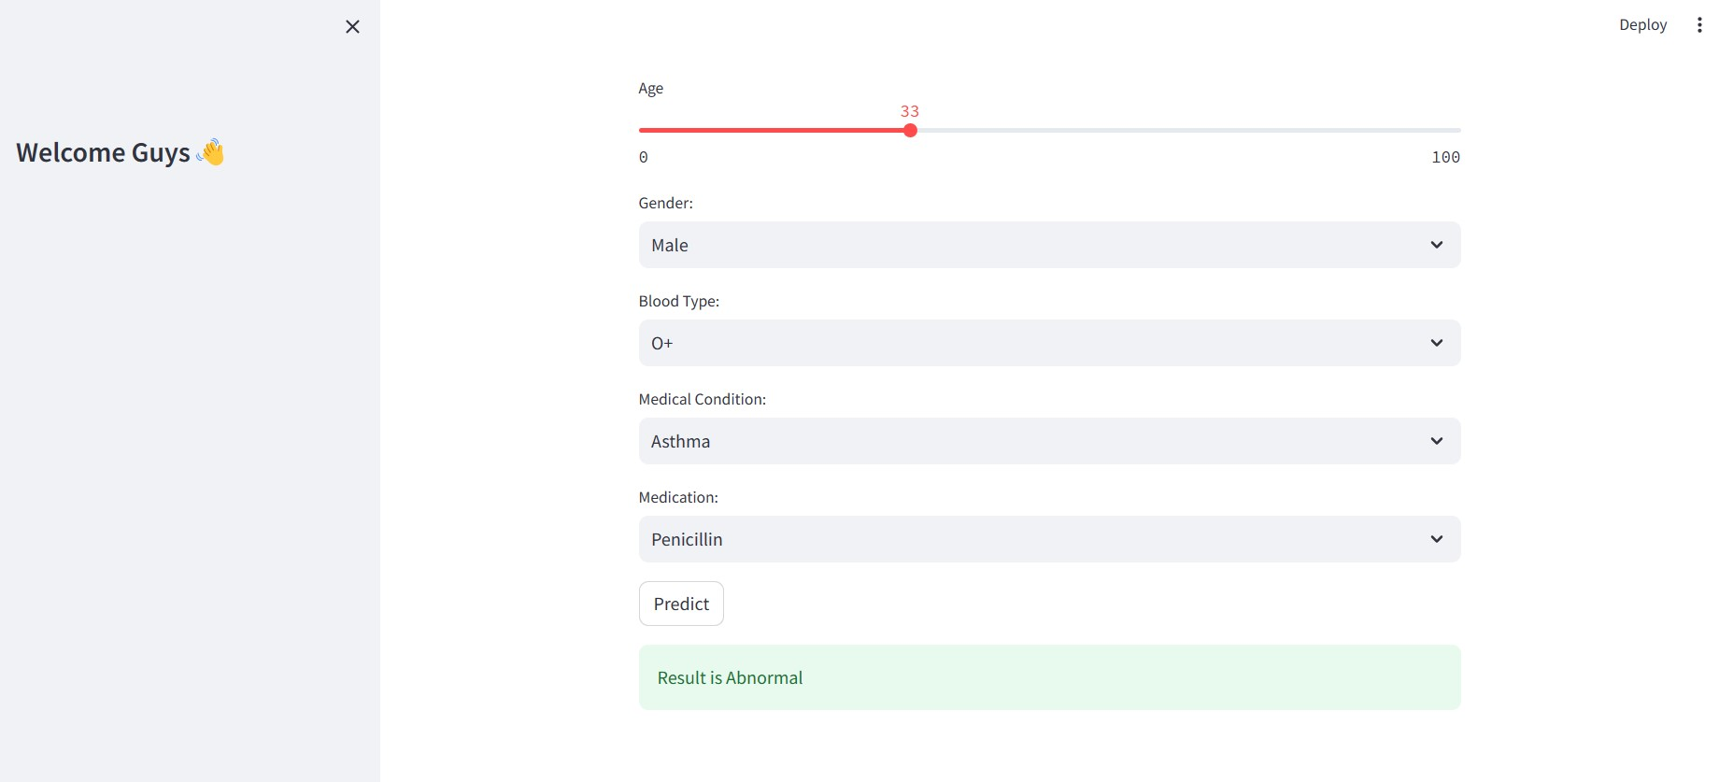

Slide 13
CONCLUSION

Slide 14
Thank you

